Slide 1

C Practice 5
Notes:
Click to add notes

Slide 2
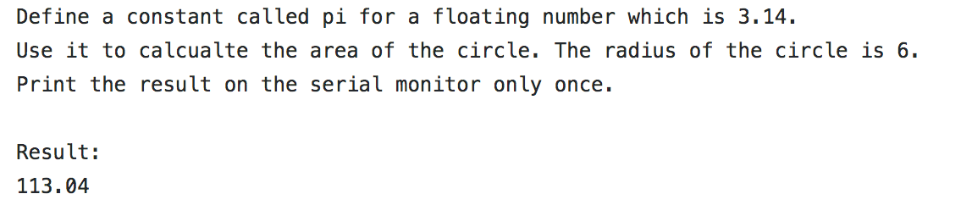

C Programming Practice Question 1
Hint:
1. float
Notes:
Lesson descriptions should be brief.

Slide 3
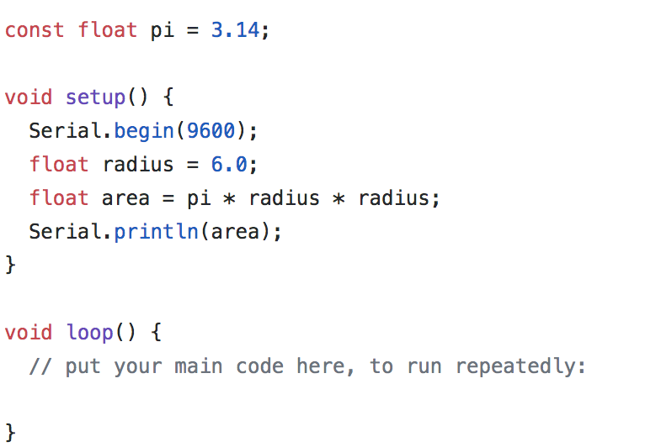
Answer
Notes:
Lesson descriptions should be brief.

Slide 4
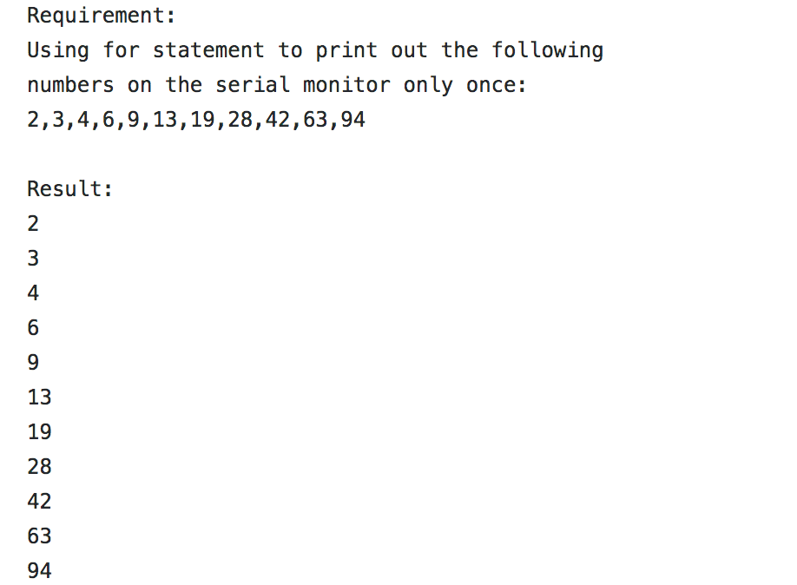
C Programming Practice Question 2
Hint:
1. for (…)
Notes:
Lesson descriptions should be brief.

Slide 5
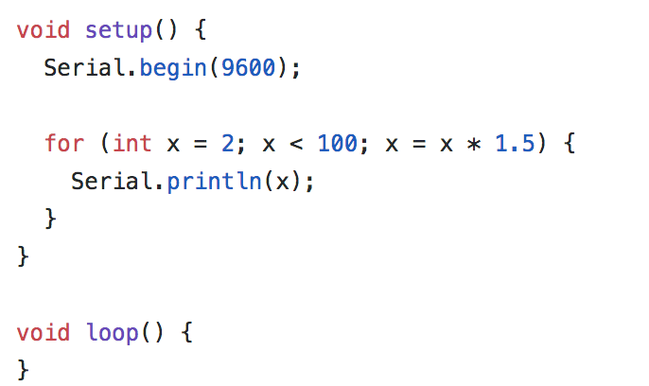
Answer
Notes:
Lesson descriptions should be brief.

